Slide 1
ON THIS DAY
DECEMBER 4
By: Ainah Therese P. Fernandez
  GRADE 6 - COURAGE

Slide 2
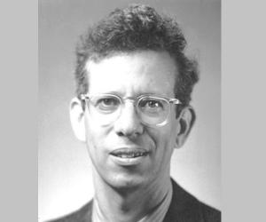
Alfred Day Hershey
1908 – 1997

Slide 3
An American bacteriologist and geneticist who won the 1969 Noble Prize in Medicine.
Born on December 4, 1908 in Owosso, Michigan
He spent He got to work along with Jacques Jacob Bronfenbrenner, a pioneer in the field of bacteriophage research.
his time as a child in Lansing where his father worked as a stocker at an automobile plant.
Hershey attended Michigan State College in 1926 and earned Bachelor’s degree in 1930.

Slide 4
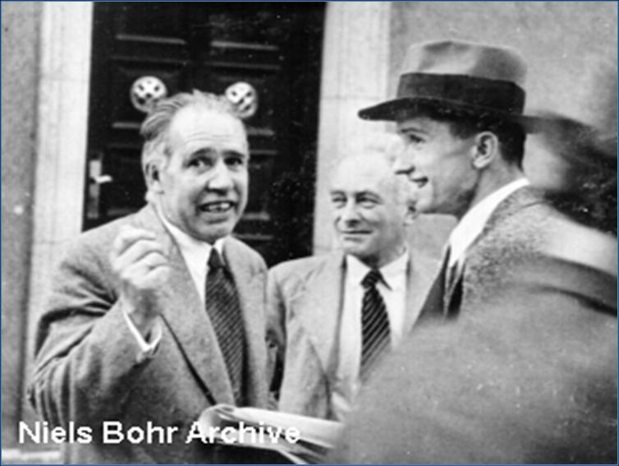
In 1945, he discovered andthat the phage viruses and the bacteria they infect can undergo spontaneous mutations. He also made an important discovery that different strains of bacteriophage can exchange genetic material when both have infected the same bacterial cell, creating a hybrid of the two. This process was referred to as ‘genetic recombination’ by Hershey.

Slide 5
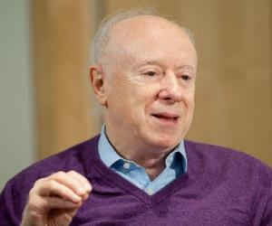
Hershey was known to be an excellent writer and editor. His papers were clear and concise and he helped other scientists learn the craft of scientific writing. He enjoyed gardening and woodworking, as well as classical music.
He died of a heart failure on May 22, 1997 in Syosset, New York. He was buried at St. John’s Church Cemetery, Oyster Bay, New York.

Slide 6

